Slide 1
Hybrid Application Control On Kubernetes (HACK ) PyRK8 Dubai – MVP Team:- Wael Kasrawani Cloud Architect Kunal Malhotra Cloud Application Developer

Slide 2
Project Summary
Project Description:
Client wants to create a customer facing application that uses watson assistant as the chatbot service, OpenShift for application development. The solution will eventually be host production on-premises on RHOS.
MVP Scope:
Project HACK is aimed at delivering a Minimum Viable Product (MVP) that aims to create a customer facing application within a Hybrid Environment that is split across IBM cloud and on-premise. It uses Redhat OpenShift to host and manage the application development that is based on of node.js. Managed Redhat OpenShift will be used on cloud and OKD hosted on a VMware node will simulate the on-premise environment. An external API integration will connect the application to Watson NLP for the interface (chatbot).
IBM Cloud / June 2019 / © 2019 IBM Corporation
2
Notes:
The Cloud Paks help to support the speed, flexibility, security and scale required for these digital transformation initiatives, and come pre-integrated with a set of capabilities he IBM Cloud Pak for Applications also help accelerate the build of cloud-native apps by leveraging built-in developer tools and processes, including support for microservices functions and serverless computing.
IBM Cloud Pak for Applications is part of a family of five IBM Cloud Paks. IBM Cloud Paks are enterprise-ready, containerized software solutions giving clients an open, faster, more secure way to move core business applications for any cloud. Pre-integrated for cloud use cases (applications, data & AI, integration, automation and multicloud management), IBM Cloud Paks are complete yet simple(fully modular and easy to consume); IBM certified as open and secure(with full software stack support and ongoing security, compliance and version compatibility); and they run anywhere(on-premises, on private and public clouds, and in pre-integrated systems).

Slide 3
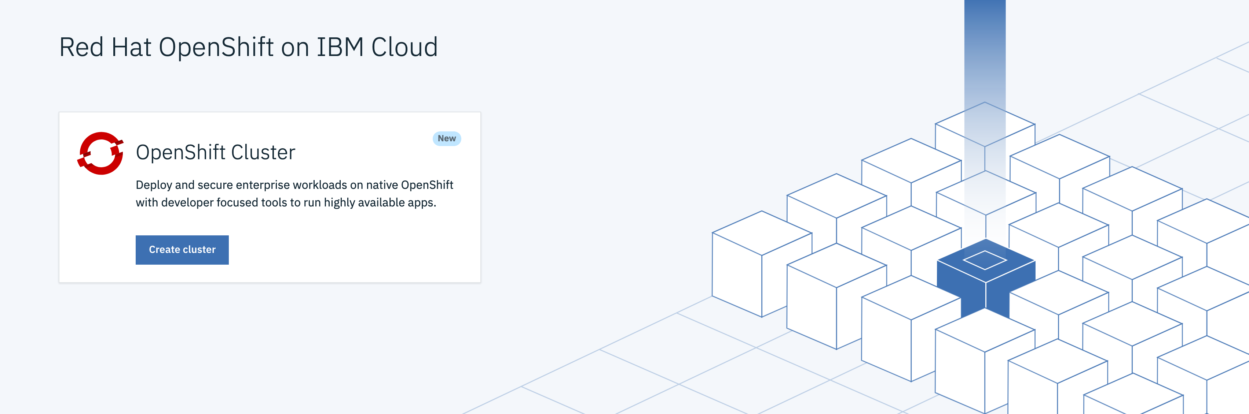
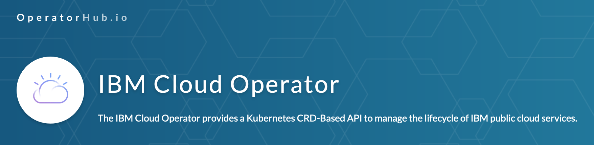
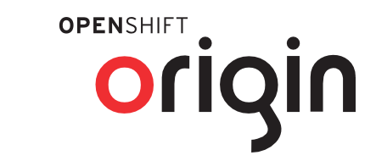
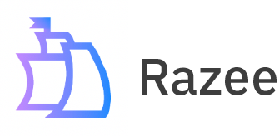

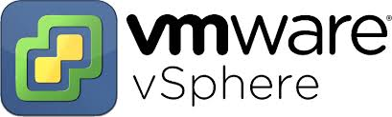

Building Blocks Of MVP

Slide 4
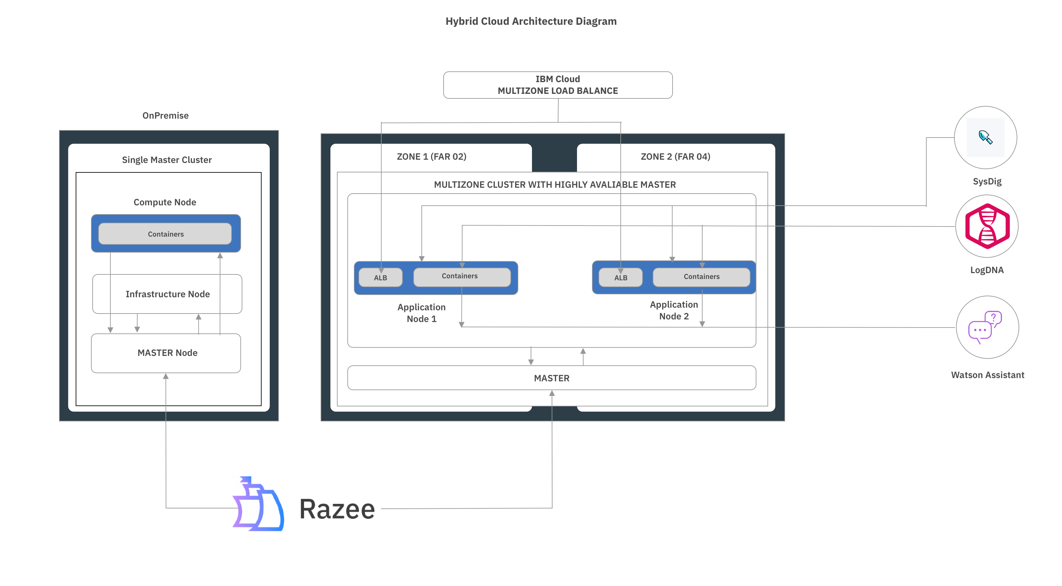
Architecture

Slide 5
DEMO

Slide 6
Thank You!!

